Slide 1
LIVE STREAMING ON A BUDGET

Slide 2
Should You Live Stream?
Will your members find it beneficial?
Do you want to expand your church’s reach?
Will it strain your church’s budget?
Will it help you reach specific church goals?
Notes:
Consider live streaming if…
A church might find it more beneficial to simply upload sermons on their website to build a following before live streaming.

Slide 3
Questions to Ask
Why do you want to live steam? (“because others are,” isn’t a good answer).
Can anyone successfully lead this project right now?
Will live streaming benefit your church?
Notes:
If you’re not sure if it’s right for your church, ask yourself these questions:

Slide 4
Get Church Support
Make sure members aren’t surprised
Have an informational meeting
Post notices in the bulletin
Consider a “No Video” seating section
Notes:
Obtaining support may seem like a crazy idea, but truly take a step back and make sure your church is on board for live streaming your services. You don’t want your church members to be in the dark and push back if they have concerns or are not on board. After all, you may need their financial support to make it all happen.
If you want to know whether your members will support this endeavor, try holding an informational meeting and gather their thoughts. Be sure to start this meeting off with top reasons why your church should be live streaming so they can get a good picture of how it will work and why you want it to work. Let them see your heart behind live streaming, and be sure to point out all of the positive benefits to your church. After you have the church’s support, things will begin to move a bit more smoothly.

Slide 5
Myths
It’s too expensive
Our church is too small
I don’t have technical support
No one will watch it
In-person attendance drop
Notes:
Some of the common misconceptions:

Slide 6
Setting Goals
100 online viewers?
More online tithing?
Outreach and ministry?
Target a specific audience?
No goals? No success!
Notes:
Before you even buy the first piece of equipment, set realistic expectations and goals. - Why? -
You need a way to measure how well live streaming your church services is working for your church.
For instance, do you want to expand your reach from 100 members to an additional 1,000 online viewers each week? Maybe you want to increase online tithing by 15%. Perhaps, you’re looking to increase engagement with your current members.
Whatever your goals are, set them before you start live streaming. By setting goals, you’re able to determine how valuable live streaming actually is for your church’s needs.

Slide 7
Live Streaming Platforms
Paid: Content Delivery Networks
Boxcast (https://www.boxcast.com/) Starts at $99 per month
Worship Channels (http://worshipchannels.com/) Starts at $99 per month
Notes:
CDN is short for content delivery network. A content delivery network (CDN) is a system of distributed servers (network) that deliver pages and other Web content to a user, based on the geographic locations of the user, the origin of the webpage and the content delivery server.
When it comes to live streaming options for churches, you have several platforms to choose from including:

Slide 8
Live Streaming Platforms
Paid: Content Delivery Networks
StreamingChurch.tv (https://streamingchurch.tv/sctv/) Starts at $79 per month
Livestream by Vimeo (https://livestream.com/) $75 per month
Notes:
CDN is short for content delivery network. A content delivery network (CDN) is a system of distributed servers (network) that deliver pages and other Web content to a user, based on the geographic locations of the user, the origin of the webpage and the content delivery server.
When it comes to live streaming options for churches, you have several platforms to choose from including:

Slide 9
Live Streaming Platforms
Paid: Content Delivery Networks
Sunday Streams (http://sundaystreams.com/) Starts at $49 per month
TruthCasting (http://www.truthcasting.com/) Starts at $25 per month for small churches
Notes:
CDN is short for content delivery network. A content delivery network (CDN) is a system of distributed servers (network) that deliver pages and other Web content to a user, based on the geographic locations of the user, the origin of the webpage and the content delivery server.
When it comes to live streaming options for churches, you have several platforms to choose from including:

Slide 10
Live Streaming Platforms
Paid: Content Delivery Networks
DaCast (https://www.dacast.com/) Starts at $19 per month
Christian World Media (http://christianworldmedia.com/) Starts at $15 per month
Notes:
CDN is short for content delivery network. A content delivery network (CDN) is a system of distributed servers (network) that deliver pages and other Web content to a user, based on the geographic locations of the user, the origin of the webpage and the content delivery server.
When it comes to live streaming options for churches, you have several platforms to choose from including:

Slide 11
Free Live Streaming Platforms
Free: Content Delivery Networks
Facebook Live (https://live.fb.com/) $0
YouTube Live (https://www.youtube.com/live_dashboard) $0
Notes:
CDN is short for content delivery network. A content delivery network (CDN) is a system of distributed servers (network) that deliver pages and other Web content to a user, based on the geographic locations of the user, the origin of the webpage and the content delivery server.
A couple free options:
Facebook Live allows you to set up live streaming events, including live streaming your church services. Youtube Live works just like the regular YouTube, except videos are broadcast live.

Slide 12
Hardware
Computer:
i5 / i7 Processor
8gb of Ram
GTX 950 - 1080 series Graphics from NVIDIA
Video Capture Device
Cell Phone / Tablet
A Newer Cell Phone or Tablet
OR

Slide 13
Encoder - Software
Encoder (Computer Software)
OBS (Open Broadcast Studio) - Free
Flash Media Live Encoder (Adobe) - Free
Notes:
An encoder is one of the most important components of any live streaming equipment. The encoder takes the information from both your video and sound sources and blends and converts it into a new format. Then it connects to you CDN to stream live video.
Encoders can be either software loaded onto a computer or a hardware (the computer and software already combined into a specially packaged unit) box.
Here are some free software options. There are lots of other software options for a price but we do not have any to recommend as they will vary in price and features.

Slide 14
Encoder - Hardware
Encoder (Hardware)
BoxCaster
Digicast
Teradek
AJA
Notes:
An encoder is one of the most important components of any live streaming equipment. The encoder takes the information from both your video and sound sources and blends and converts it into a new format. Then it connects to you CDN to stream live video.
Encoders can be either software loaded onto a computer or a hardware (the computer and software already combined into a specially packaged unit) box.
Here are some free software options. There are lots of other software options for a price.

Slide 15
Hardware - Cameras
Webcam
Tricky to work
connected to a Computer
cheap option
DSLR Camera
Digital Single Lens Reflex
Designed for high-quality
Prefered by pro photographers
Camcorder
Designed for video
Obvious First Choice
Need Wi-Fi or HDMI
Action Cameras
Designed for moving
Best stability
Cell Phone or Tablet
Great for Facebook Live
Great for YouTube Live
Easily Available

Slide 16
Hardware - Audio
Audio Source
House Sound (soundboard)
External Microphone
Camera Microphone
Notes:
To capture the best sound I recommend using the sound from the church sound board.
If that isn’t possible then an external mic (not built into other equipment) is a good alternative.
The mics built into cameras can be decent but often there is a limitation to the sound quality.

Slide 17
Youtube & Facebook with Cell Phone or Tablet
Helpful Tips:
Strong 4G Connections should work
Test that your Upload speed is 5mbps & up
Have a full battery or be plugged in
Turn on Airplane Mode
Facebook Live is good for Live but not great for Archived
YouTube Live is great for both Live and Archived
Notes:
Here are some suggestions to using a cell phone or tablet with either Youtube Live or Facebook Live.

Slide 18
The Downside to Free
Every event is scheduled independent of each other
Different URL’s
Both Youtube and Facebook detect and remove copyrighted content.
Notes:
There are some downsides to taking the free route.
.Every event (each Sabbath Sermon) must be scheduled independently of each other - different URL’s for each and every stream.
Both Youtube and Facebook use sophisticated algorithms to detect any copyrighted content. If found, the archived video will be removed automatically by Youtube or Facebook.

Slide 19
thanks!
Help.AdventistChurchConnect.com
Ticket.AdventistChurchConnect.com
Support@AdventistChurchConnect.com
877-518-0819
Facebook.com/achurchconnect
Notes:
Contact Us!
Help.AdventistChurchConnect.com
Ticket.AdventistChurchConnect.com
Support@AdventistChurchConnect.com
877-518-0819
Facebook.com/achurchconnect

Slide 20
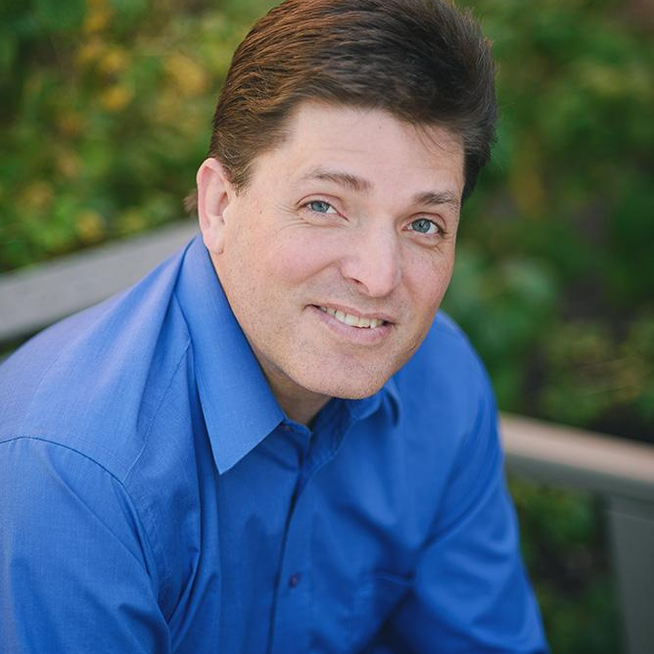
Who Are We
Lonny Nelson
Helpdesk Technician & Trainer
Notes:
Contact Us!
Help.AdventistChurchConnect.com
Ticket.AdventistChurchConnect.com
Support@AdventistChurchConnect.com
877-518-0819
Facebook.com/achurchconnect

Slide 21
Who Are We
Cody Moser
Helpdesk Technician & Trainer
Notes:
Contact Us!
Help.AdventistChurchConnect.com
Ticket.AdventistChurchConnect.com
Support@AdventistChurchConnect.com
877-518-0819
Facebook.com/achurchconnect

